Slide 1




Develop a platform for the discovery and analysis of correlates of protection
DiCAIDS {DIgital and Computational Approaches to Infectious Diseases Study}
Emmanuel OLAMIJUWON,
Adeniyi Francis Fagbamigbe,
Kehinde Aruleba
@eolamijuwon

Slide 2
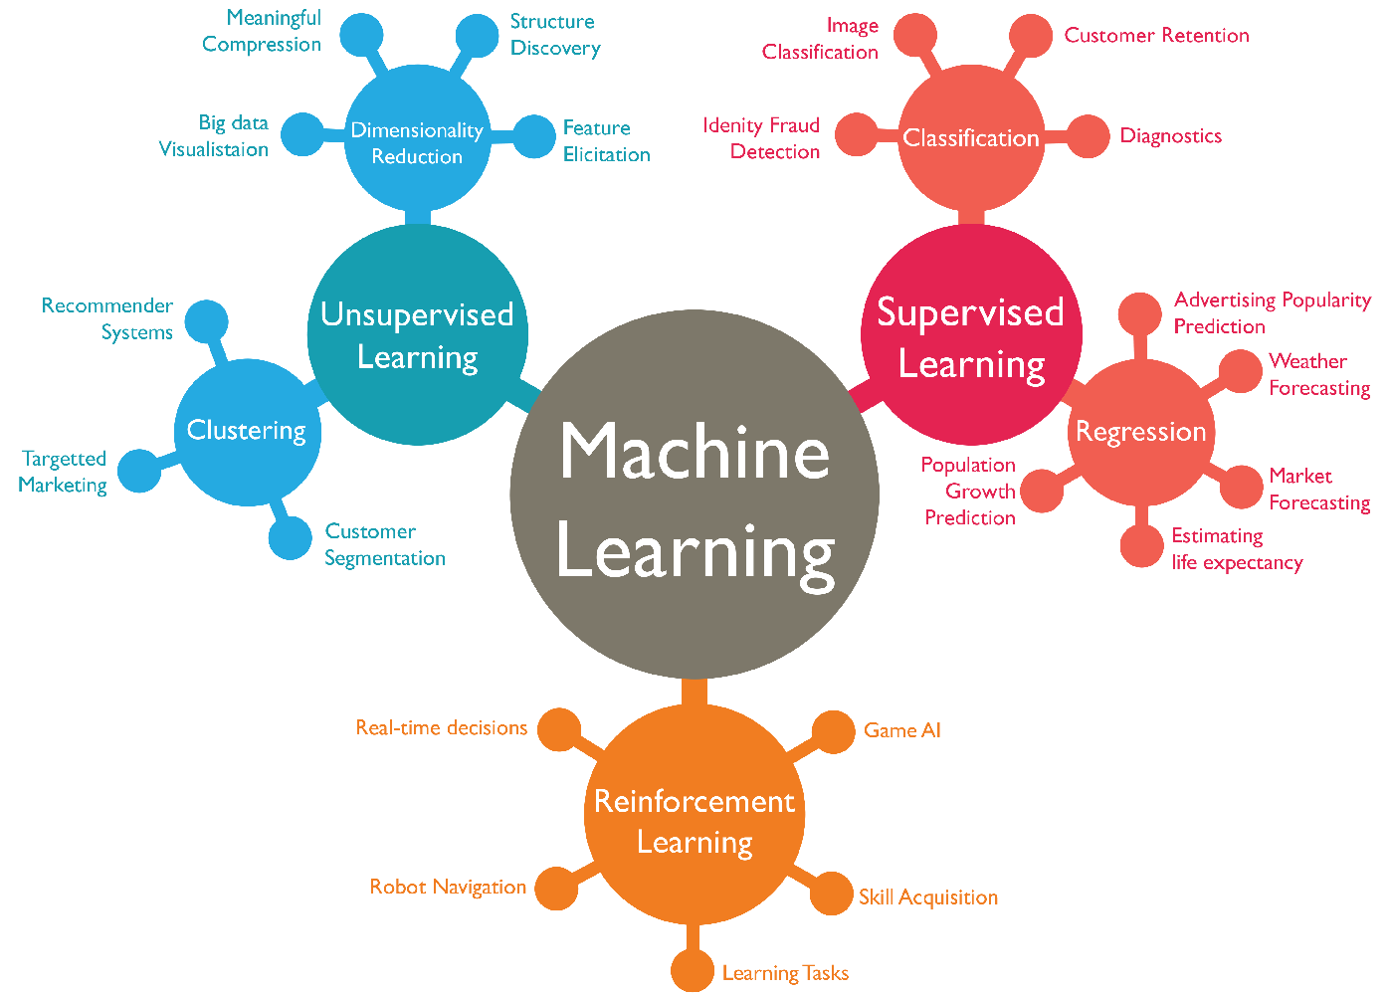
Motivation
There’s a huge burden of infectious diseases in low-and-middle-income countries (LMICs).
There have also been recent advances in vaccine research and development in low-and-middle-income countries (LMICs).
© https://www.wordstream.com/

Slide 3
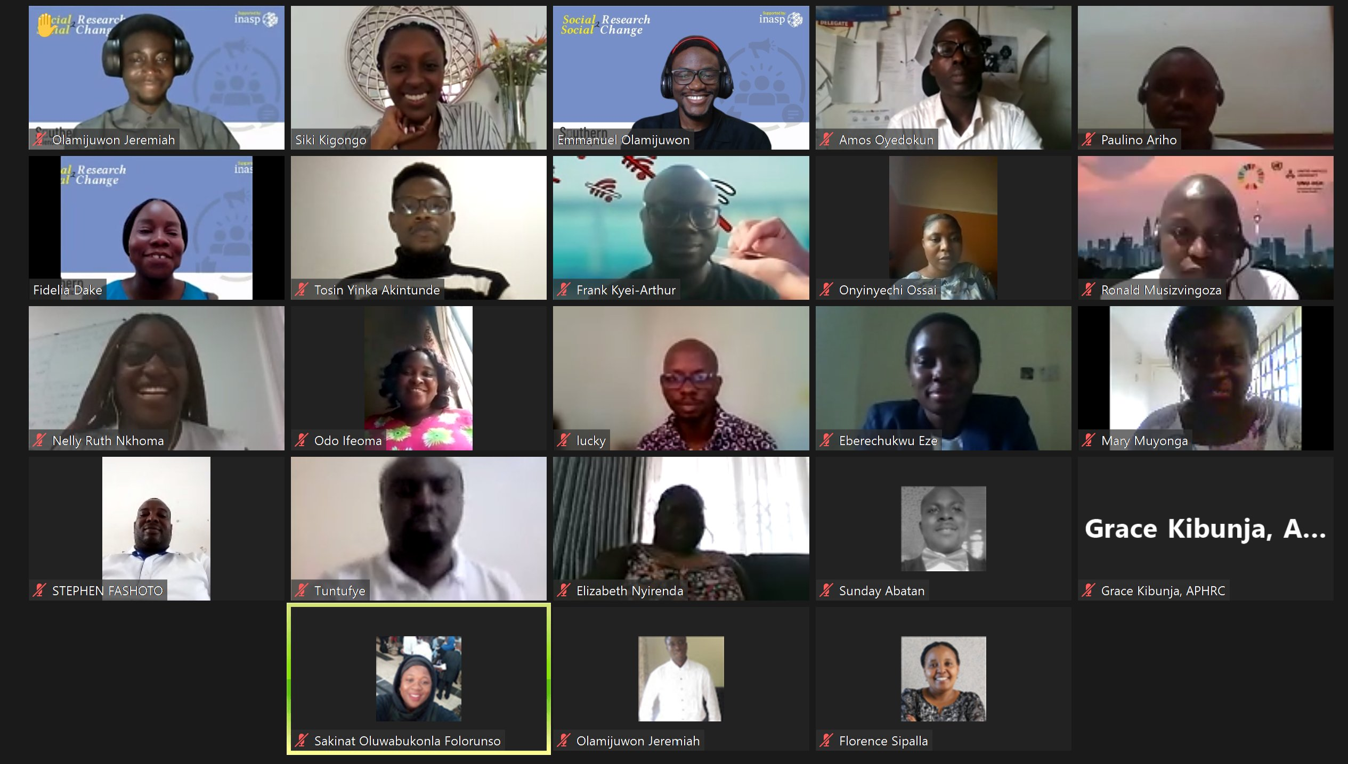
Lack of data science skills and computational infrastructure limit research(ers) in LMICs
“the lack of confidence in data science skills poses one of the greatest barriers to data-sharing practices among researchers in LMICS.”
A cross-section of participants at the social research 2 social change: breaking barriers in science communication and collaboration in African countries using artificial intelligence

Slide 4
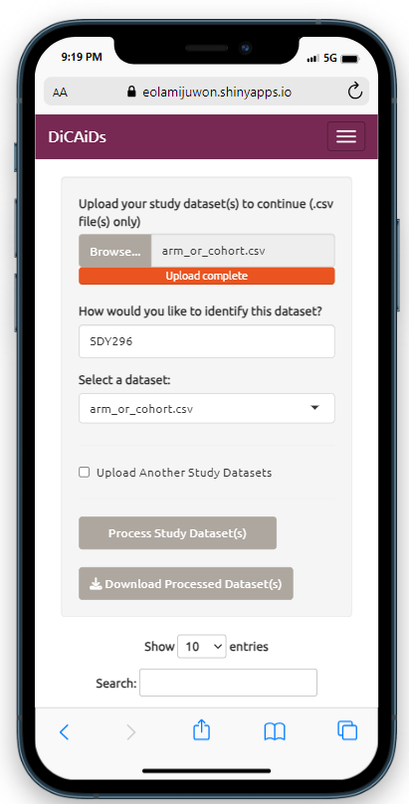
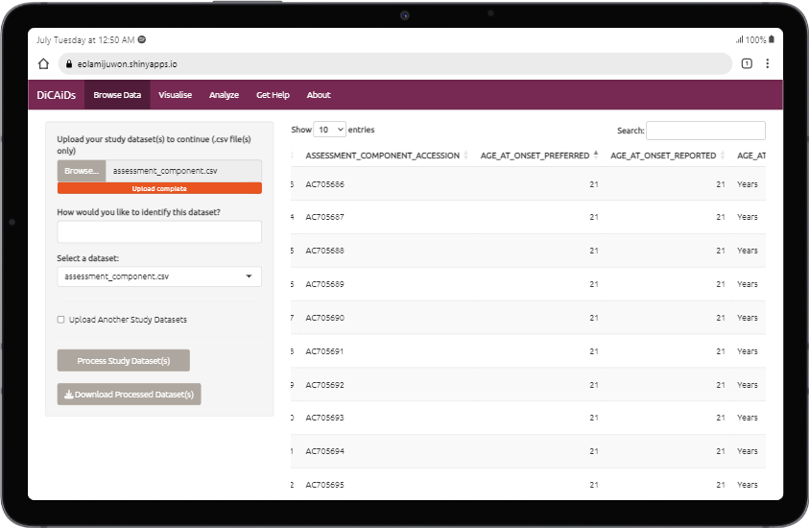
Our Solution
No Code
User-friendly
Responsive

Slide 5
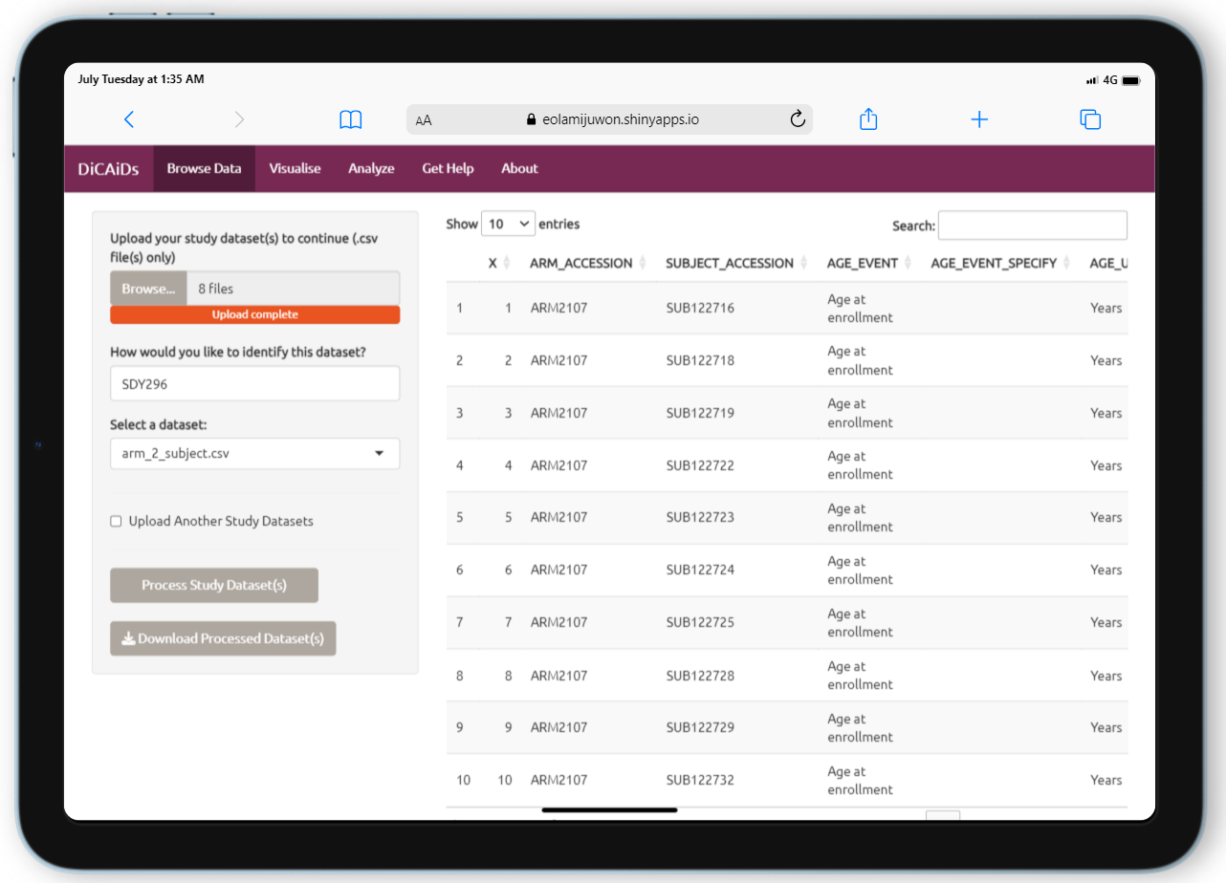
Our Solution

Slide 6




Our Solution
Study Datasets 1
Model results & performance
Data Visualisation
Data Analysis
Prevalence of Infection
Prevalence of Antibody Seroconversion
Antibody level patters
Classical
Statistical
Methods
ML-methods
Mean Antibody Titers
Feature extraction
Unconnected Study Dataset
Regression models
Pairwise correlations
Interpretable ML Model Specification
Study Datasets 2

Slide 7
Our Strategy:
Working with Biostatisticians
Early establishment of clear communication with relevant biostatisticians
Define platform objectives and scope
Understand the regulatory landscape
Collaborate on study design
Document the analytical process
Seek regulatory guidance

Slide 8
Our Strategy:
Generalisability to new diseases/vaccines
Use a diverse and representative data
Implement transfer learning
Regularly update and retrain the models on the platform
Evaluate, validate and test platform with diverse datasets
Encourage data sharing
Perform rigorous feature engineering and selection:

Slide 9
Our Strategy:
Working with government stakeholders
Engage relevant stakeholders early
Educate and demonstrate value
Prioritise safety and ethics
Collaborate on data privacy and security
Conduct rigorous validation studies
Address public concerns and foster public engagement

